Slide 1

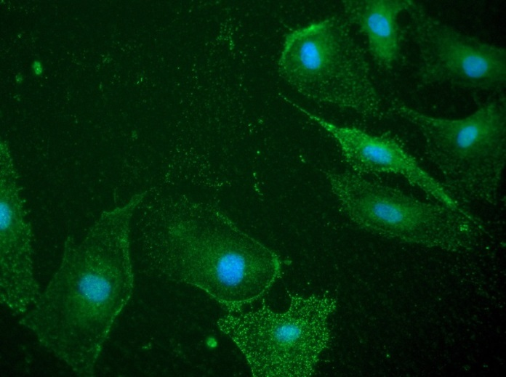
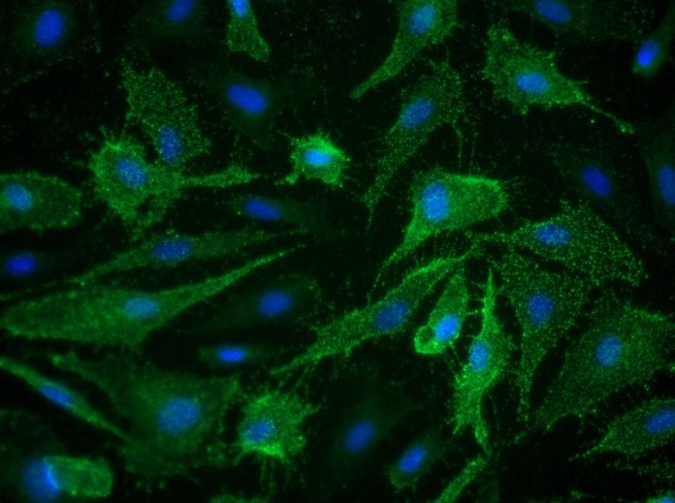
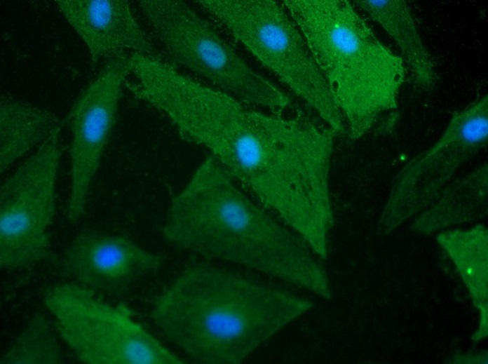
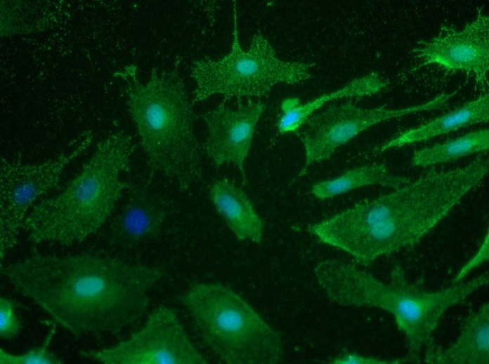
Reliatech GmbH
Rabbit anti-human LYVE-1
(Cat# 102-PA50AG)
Immunofluorescence staining of human LYVE-1 in primary human lymphatic endothelial cells (HDLEC) using a polyclonal rabbit anti-human LYVE-1 (#102-PA50AG) antibody.
As secondary antibody goat anti-rabbit ALEXA Flour 488 (Dianova) was used 1:400. [IF_LEC1401-03]
.
0,5µg/ml
2µg/ml
5µg/ml
10µg/ml
http://www.reliatech.de / orders@reliatech.de

